Slide 1


Aditya Case Study Assessment :
Predicting Loan Defaults
GROUP 7
1.A.Naga Praveen.
2.P S D Sita Mahalakshmi.
3.R.Suresh.
4.R.Rahul.
5. G.Alekhya.
6.N.Siva Manikanta.
7.B.Sai Hemanth.

Slide 2


Business Objective
Understanding
The Lending companies wants to make sure about the customers before they investing money on them they rely on some predictive analysis to make smarter decisions and lend money on the right customer.
Before lending the money to the customer the company should know the correct info of the customer.
The company should identify the fully paid and non fullt paid customers by performing smarter techniques.
And lending money to the preferable customers like the company had no risk.

Slide 3

Approach
A starting point we have to perform analysis on the Fully paid and Non-Fully paid profiles results compared to different features in the data science .
Splitting our target variable into to samples and then perform analysis on How features are changed according to the data.
Another way is to split the whole data into dependent (target) and independent features.
Test and train the data to split for seeking the future customers more likely to fully paid.

Slide 4


Data Health Review
Variables
1.The given data consists of the datatypes i.e Float(6),Integer(7) and Object(1).
2.There isn't any affected variable in the given data.
Missing Values
There are no missing values for the variables in the given data .
Outliers
We observed some outliers in some variables. And we are taken care of capping and flooring.
Duplicate Records
The data doesn't contain any duplicate records. It is consistent.

Slide 5
Extended Data Dictionary
 | Variable Type | Min | Pc 1% | Pc 5% | Pc 25% | Pc 50% | Mean | Pc 75% | Pc 95% | Pc 99% | Max | % Missing values | % Unique values
credit.policy | int | 0.0 | 0.0 | 0.0 | 1.0 | 1.0 | 0.8 | 1.0 | 1.0 | 1.0 | 1.0 | - | 0.021
int.rate | float | 0.06 | 0.07 | 0.07 | 0.1 | 0.1 | 0.1 | 0.1 | 0.1 | 0.1 | 2.1 | - | 2.6
installment | float | 15.67 | 33.1 | 65.55 | 163.7 | 268.95 | 319 | 432.7 | 756.2 | 870.3 | 9.4 | - | 49.99
log.annual.inc | float | 7.54 | 9.39 | 9.91 | 10.5 | 10.92 | 10.9 | 11.2 | 11.9 | 12.4 | 1.4 | - | 20.745
dti | float | 0.0 | 0.07 | 1.27 | 7.21 | 12.6 | 12.6 | 17.9 | 23.6 | 26.24 | 2.9 | - | 26.404
fico | int | 612.0 | 642.0 | 657.0 | 682 | 707 | 710.8 | 737.0 | 782 | 802.0 | 8.2 | - | 0.453
days.with.cr.line | Float | 178.95 | 570.03 | 1320 | 2820 | 4139 | 4560.7 | 5730 | 9329.9 | 12930.0 | 1.7 | - | 28.054
revol.bal | int | 0.0 | 0.0 | 127.7 | 3187 | 8596 | 16913.9 | 18249.5 | 57654 | 156762.5 | 1.2 | - | 82.157
revol.util | float | 0.0 | 0.0 | 1.1 | 22.6 | 46.3 | 46.7 | 70.9 | 94.0 | 98.92 | 1.1 | - | 10.806
inq.last.6mths | Int | 0.0 | 0.0 | 0.0 | 0.0 | 1.0 | 1.5 | 2.0 | 5.0 | 9.0 | 3.3 | - | 0.292

Slide 6
Variable understanding:
 | Variable Type | Min | Pc 1% | Pc 5% | Pc 25% | Pc 50% | Mean | Pc 75% | Pc 95% | Pc 99% | Max | % Missing values | % Unique values
delinq.2yrs | Int | 0.0 | 0.0 | 0.0 | 0.0 | 0.0 | 0.1 | 0.0 | 1.0 | 2.2 | 1.3 | - | 0.115
pub.rec | Int | 0.0 | 0.0 | 0.0 | 0.0 | 0.0 | 0.06 | 0.0 | 1.0 | 1.0 | 5.0 | - | 0.063
not.fully.paid | int | 0.0 | 0.0 | 0.0 | 0.0 | 0.0 | 0.1 | 0.0 | 1.0 | 1.0 | 1.0 | - | 0.021
purpose | int | 0.0 | 0.0 | 0.0 | 2.0 | 3.0 | 4.12 | 7.0 | 10.0 | 14.0 | 17.0 | - | 0.073
From the data we have 14 variables from those there is only one object variable(Purpose).
Remaining 13 variables are integers and float type data types.
Revolving balance has high number of unique variables in the data.
Credit policy , enquiry , delinquency , target has discrete variables in the data compared to remaining variables.
This is all about variable understanding from the raw data.
There are no dummy values in the data.

Slide 7
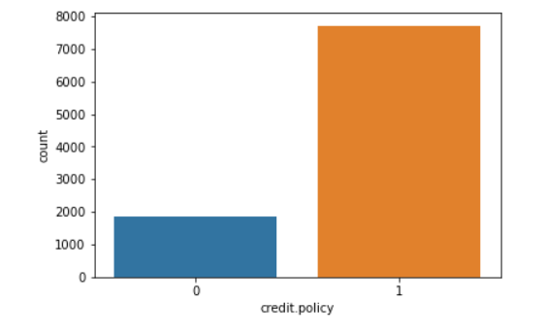
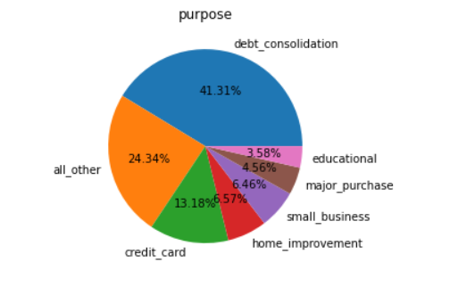
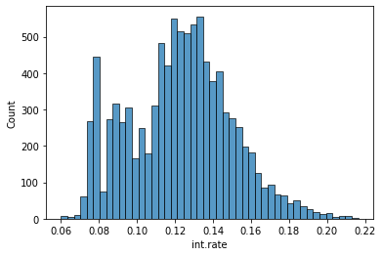
Univariant distributions
Key Findings:
From this pie chart we interpreted that they mostly take loans on the purpose of debt_consolidation.
Credit Policy
Purpose
Key Findings:
The customers who meet the credit under writing will be high compared to others.
The customers who didn’t meet the credit under writing will be assumed as risky guys.
Key Findings:
Most of the loan takers have an average rate of 0.13.
Most of the members interest rate is 0.12 to 0.16.
Interest rate

Slide 8
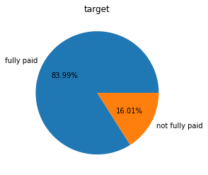
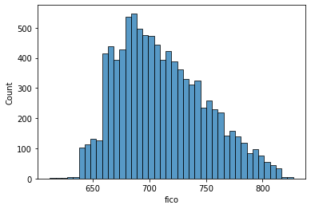
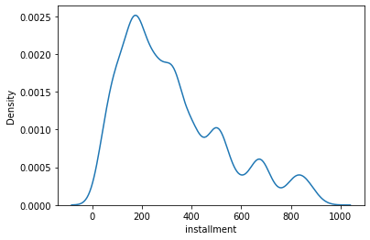
Univariant distributions
Credit Score
Installment
Pay Default
Key Findings:
Key Findings:
Key Findings:
All customers have credit score of 650 to above 800.
No customer have below 650.
Below 650 will be the bad credit score.
From the kde plot more customers have paying installment from 100 to 400.
High installment customers density will be low.
From the pie chart fully paid customers are 84% and not fully paid customers are 16%.

Slide 9
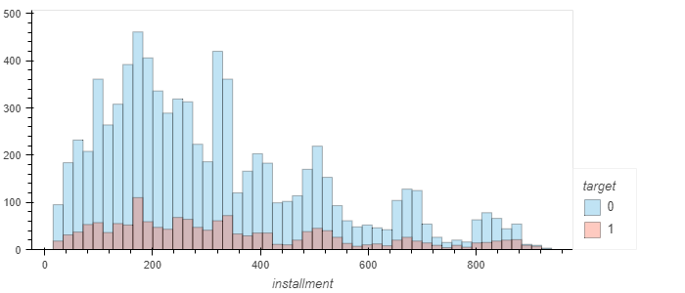
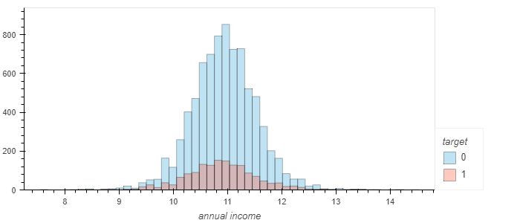
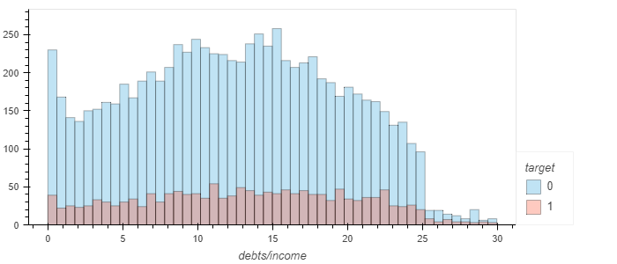
Bivariate distributions
Installment vs pay default :
Annual Income :
Debt income Vs Pay default :
Key Findings:
Key Findings:
Key Findings:
Full paid customers and non fully paid customers have same installments.
The annual income for fully paid customers is very high when compared to non paid customers.
From this plot the debt income ratio for the fully paid customers is more compared to non fully paid customers.

Slide 10
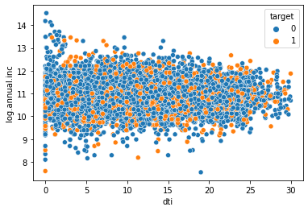
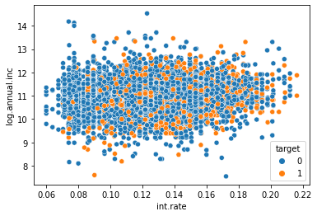
Bivariate distributions
From the scatter plot we interpret that the debt to income ratio is low for high annual income loan takers.
From both of the scatter plots we observed that there will be non linear data points.
From both of the scatter plots we observed that there will be non linear data points

Slide 11
Analysis/ Modeling Methodology
Data Preparation & EDA
New variable creation & Selection
Model Development
Sub-setting (keeping relevant variables/records, e.g. splitting the target variable and seeing what happens in features.
Extensive bi-variate analysis conducted on all meaningful variables.
Rename the features into meaningful ones.
1 new variable is modified ( days to years ) for better understanding.
1 variable is dropped off after Feature Engineering since they weak correlation with dependent variable.
Used pandas get dummis to create dummy variables ( get dummies ).
Decision tree is chosen as the preferred modeling technique since the predicted feature is discrete.
We also use Logistic Regression for this.
We develop the model based on the metrics.

Slide 12
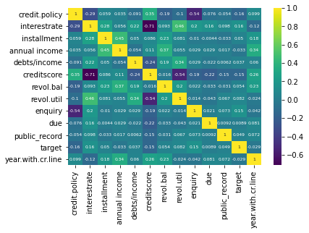
Correlation plot
Key Findings:
From this correlation plot we observed that there is negative correlation (Inversely proportional).
Then we can say that credit score and Interest rate are negatively correlated.
Then we drop one of the variable from both.

Slide 13
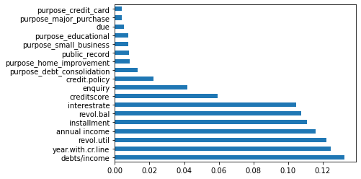
Features importance
Key Findings:
From this chart , we interpret that debts/income is the most important variable in this.
And we see importance of features in the data given.
Due feature has less importance.
Annual income , Interest rate are also having higher importance while predicting the target.

Slide 14
Why this Algorithm ???
From the business problem we see that the independent variable which is target variable will be discrete.
when the target variable is discrete we clearly say that this is a classification problem.
And we see that in the data there are two classes in the data then we say that this is a binary classification.
From the binary classification the best and intial algorithm used will be Logistic Regression.
For this problem we use Decision Tree Classifier.
Another algorithms to be used – KNN , Naïve Bayes , SVC , Random Forest.

Slide 15
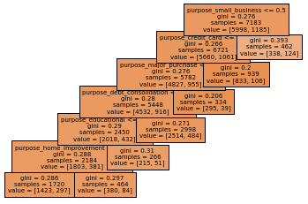
Decision tree for categorical variable :
From this decision tree we see the decision categorical variables .
We know that split for categorical variable is based on
- Entropy.
- Gini.
Whenever the Gini value is nearer to zero its the pure and best split.

Slide 16
Model building
After completing all the pre processing steps we would step into build the model.
For building the model firstly we divided the dataset into 75% for training and 25% for testing the model.
After that we choose our algorithm from the required sources (sklearn).
Later we fit training data to our model.
Finally we test the data using some “classification metrics”.
Model evaluation metrics
Confusion matrix.
Classification report.
Accuracy.
Auc-roc curve.

Slide 17
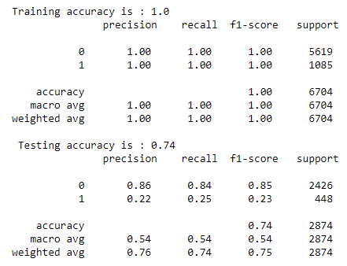
Model evaluation(raw)
From this classification report we can say that in testing in precision, recall and f1-score will be decreasing in labels.
There will be around 2500 in 0’s and 500 in 1’s.
Then we say that there will be class imbalance in the data.
And the class imbalance will be balanced by the.
By smote.
By random over sampler.

Slide 18
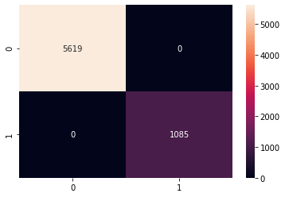
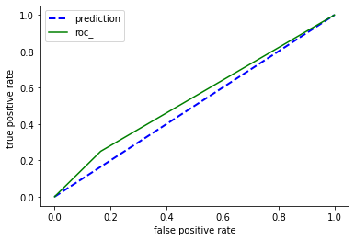
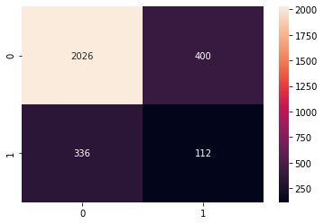
Confusion matrices
Key Findings:
The auc score for the general model is 49.3%.
To increase the scores we balanced the data.
In confusion matrix the x axis is actual labels and in y-axis there will be predicted labels.

Slide 19
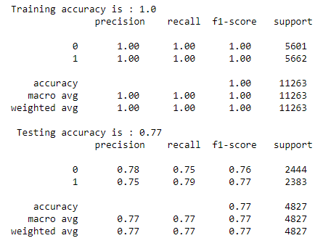
Classification report for balanced model (smote):
In this model the class labels are to be balanced.
We see that the testing accuracy will be low , then we say that it could be overfitting.
To generalize the model we need to prune the decision tree.
Lets see what happens when we prune the data.

Slide 20
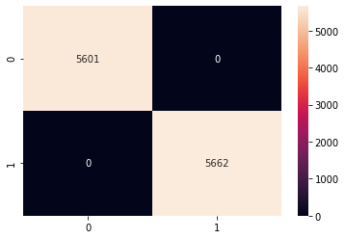
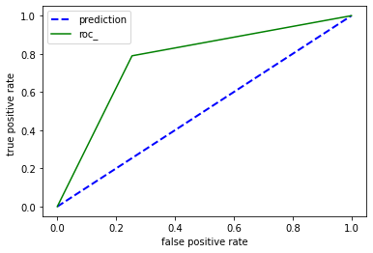
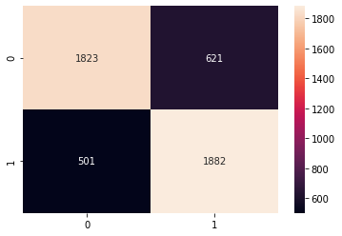
The auc score is about 70%.
From the confusion matrix false positives and false negatives are more.
For every model we need to decrease those...
For that we improve hyper parameters

Slide 21
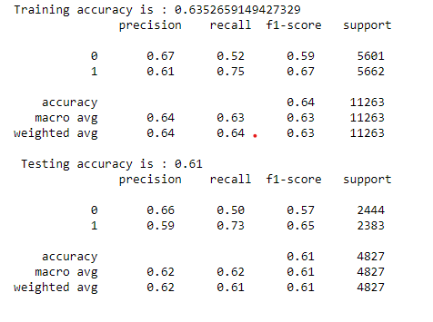
Classification report for pruned data
Hyper parameters | value
Max depth | 11
Min samples leaf | 2
Min samples split | 1

Slide 22
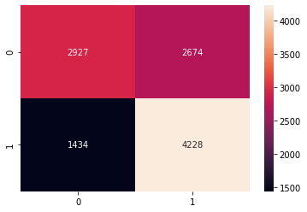
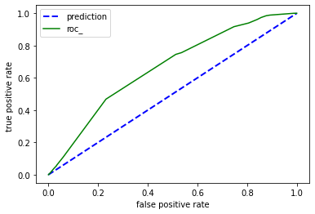
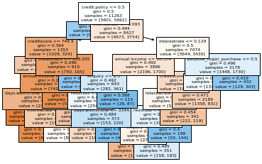
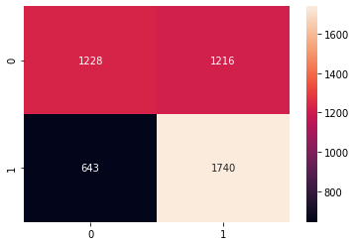

Slide 23
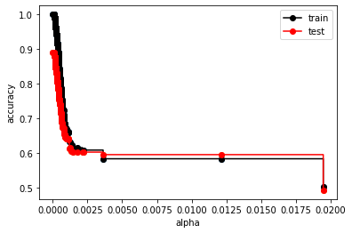
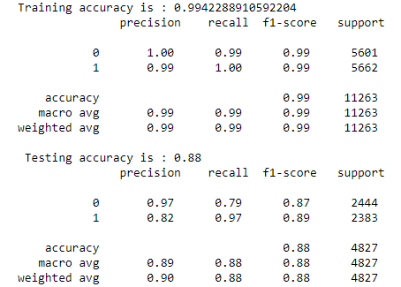
Post pruning
In post pruning we need to update cost complexity pruning value , for that we plot accuracy vs alpha graph.
From the graph we took the best alpha values lower the alpha value better the model.
Now we can clearly see that accuracy precision recall are became high compared to previous one.

Slide 24
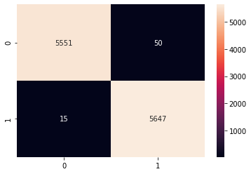
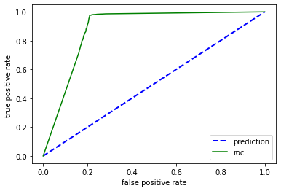
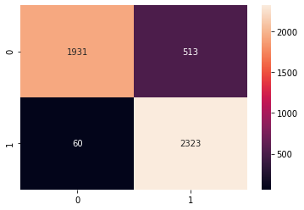
The auc score this model is 86%.
And there will be less bias and less variance.
Here true predictions to be increased.
For better model there will be one pre-processing step called pca (principle component analysis).
Lets what happens when we apply this.

Slide 25
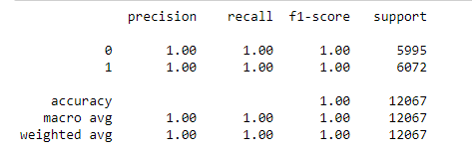
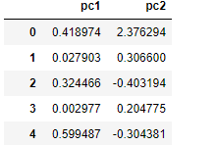
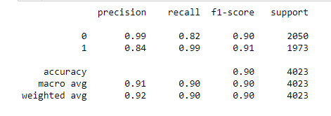
Principle Component Analysis(pca) :
In this step we convert the all the features into 2-dimensional data.
In the pca we need scaling.
When we apply pca whether the true predictions are increased or not , lets see what happens in confusion matrix.

Slide 26
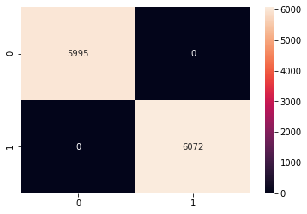
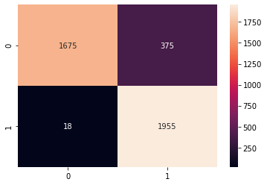
In this model we see that false positives and false negatives are decreased and we will reached the aim for our model.
Finally we take it is a final and generalized model for our data.
Here we observed that auc-roc score is high.
The cross validation score for this model will be 89%.
We also apply post pruning to this

Slide 27
TECHNICAL REQURIEMENTS NEEDED BY THE CLIENT:
The client should have a data sheets in Excel and should use libraries like NumPy, Pandas, Visualization tools for the better understanding of the distribution of the data and they should know about libraries we shown in previous slides.
The type of data cleaning and pre-processing that the client needs to make is:
- The missing values are needed to be taken care of.
- There shouldn’t be any duplicated records.
- we don’t do anything on outliers because decision trees are not sensitive
to outliers.
- Drop irrelevant features.
- Scaling is not required.
- Splitting the dataset into training and testing.

Slide 28
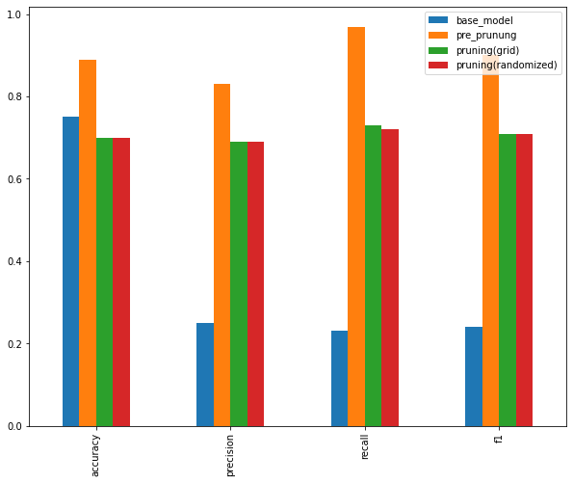
Key points:
In part of feature scaling we drop some unimportant variables and we observe very less decrease in metrics.
When we sub splitting the data on target variable we see some differences in the features.
Evaluation metrics graph for candidate models
In candidate models post pruning has high metrics

Slide 29


